Slide 1
Unit 2
Intelligent Agents

Slide 2
Intelligent Agent Paradigm
Objectives:
Agent
Intelligent Agent
Rational Agent
Different types of environment
Explain classes of intelligent agents
Applications of Intelligent agent

Slide 3
Agents:
An agent is anything that can be viewed as perceiving its environment through sensors and acting upon that environment through actuators/effectors.
A human agent has eyes, ears and others for sensors Similarly hands, legs, mouth and other body parts for effectors.
A robotic agent substitutes cameras and infrared range finders for the sensors and various motors for the effectors.

Slide 4
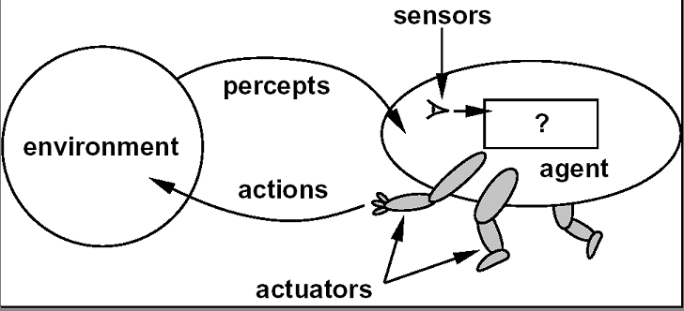
Agent and Environment

Slide 5
Agents
Operates in an environment
Perceives its environment through sensors.
Acts upon its environment through actuators/effectors
Have goals.

Slide 6
Sensors and Effectors
An agent perceives its environment through sensors.
The complete set of inputs at a given time is called percept.
The current percept or a sequence of percepts can influence the actions of an agent

Slide 7
Sensors and Effectors
It can change the environment through effectors
An operation involving an actuator is called an action.
Actions can be grouped into action sequences.
So an agent program implements mapping from percept sequence into actions.

Slide 8
Agents
Autonomous Agent: Decide autonomously which action to take in the current situation to maximize progress towards its goals.
Performance measure: An objective criterion for success of an agent’s behaviour.
Eg. Performance measure of vaccum cleaner agent could be amount of dirt cleaned up, amount of time taken, amount of electricity consumed , amount of noise generated etc.

Slide 9
Structure of Agent
Agent Function:
The agent function maps from percept sequences to actions:
F: P* → A
Where p* is the complete set of percept sequence and A is the action
The term percept

Slide 10
Intelligent Agents
Intelligent Agent
Must sense
Must act
Must be autonomous (to some extent)
Must be rational.

Slide 11
Rational Agent
AI is about building agents
An agent is something that perceives and acts.
A rational agent always does the right thing.
What are the functionalities (goals )?
What are the components ?
How do we build them ?

Slide 12
Rationality
Perfect Rationality:
Assumes that the rational knows all and will take action that maximizes utility
Human beings do not satisfy the definition of rationality.

Slide 13
Environments
To design a rational agent we must specify its task environment. Task environment means:
PEAS description of the environment:
– Performance
– Environment
– Actuators
– Sensors

Slide 14
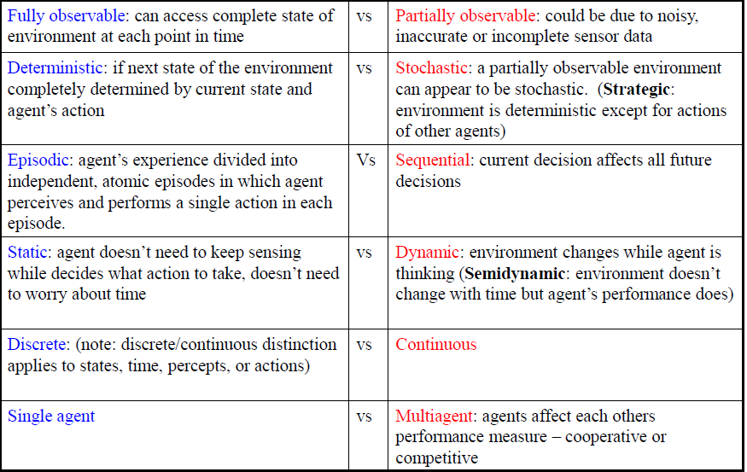
Properties of Environment/Types of Environment

Slide 15
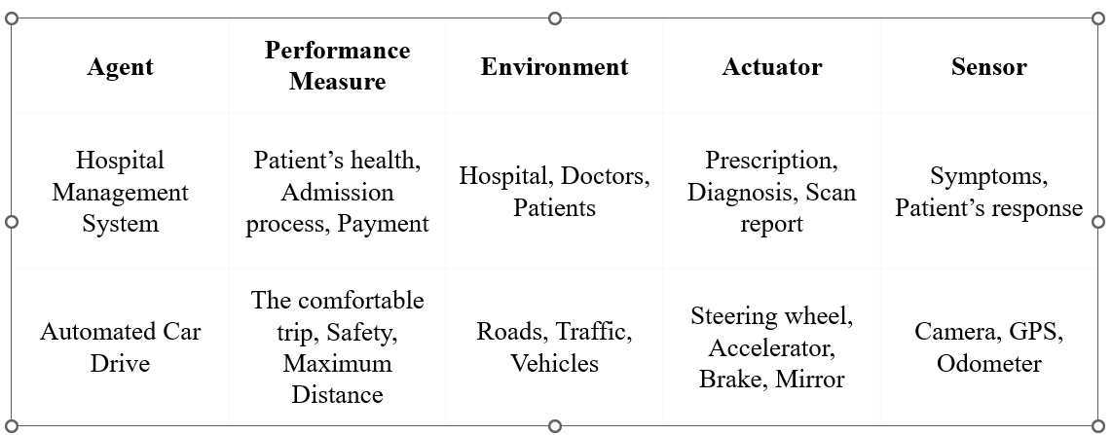
AI Agents with PEAS Framework Examples

Slide 16
Advantages of PEAS in AI
Structured Design:
Versatility:
Goal-Oriented:
Systematic Development:

